Slide 1

Introduction to Data Science

Slide 2

Disclaimer
The purpose of this course is cover the Statistical Methods for analyzing data by using SAS software (like SAS/Stat, SAS/Graph, SAS/ODS, SAS/Base and SAS/Advance) and Python (Pandas, Numpy, Matplotlib, Statmodels, Scipy and so on).
Good to have basic knowledge of programming in any language.

Slide 3
Definition of Data
An organization is collecting and maintaining the large amount of data for their decision making process, business growth by analyzing hidden facts and trends
Data is an information on different aspects of business which we need to analyze and manage
For rapid growth of data, the main challenge is to managing and analyzing the large data efficiently

Slide 4
Difference between data management and Data analytics
Many times we encountered to Data Management and Data Analytics and we consider both are same. But it is not!!!
Data management comprises all the disciplines related to managing, structuring and manipulating data as a valuable resource.
Data Analytics on the other hand comprise of techniques which can help to discover hidden facts and patterns from the data

Slide 5
Difference between data management and Data analytics
For Example:
- Extracting first 10 customers in terms their visit pattern is a simple query or data management
- However, to know which are the most likely customers purchasing the products based on visit pattern is a data analytics
- Dividing the customers of a company according to their profitability is a data management activity.
- Predicting the future stock price of a company using historical
records is a data analytics activity.

Slide 6
Levels of Measurement and Variable types
An analyst must consider level of measurement of variable of interest.
Four Level of Measurement as follow:
- Nominal: Nominal Variables have values with no logical ordering. For example type of Beverage is nominal variable (even though numeric values are assigned to the categories)
- Ordinal: Ordinal variables have values with logical ordering. For example size of Beverage (like small, medium, large) is ordinal variable. However you can not measure the relative distance between the values.

Slide 7
Levels of Measurement and Variable types
For a mathematical completion, there are two other types of levels of measurement as follow:
- Interval and Ratio: Interval and Ratio variables have shared the common property that we are able to calculate distance between the two ranked values. Ratio variables differ from that of interval in the existence of a “true” zero point. This zero point allows us to calculate the ratios.

Slide 8
Levels of Measurement and Variable types
Before we analyzing the data, we also need to keep in mind the types of variables as follow:
- Continuous: Continuous Variables, in theory, can take any of an infinite number of possible values between two numbers. An example of Continuous variable would be temperature of beverage. There is no restriction on numbers between 22 degree and 23 degree.
- Categorical: Categorical variables are the variables which represent the grouping and it can be stored as numeric or non-numeric values in SAS. For Example, Gender (Male and Female)

Slide 9
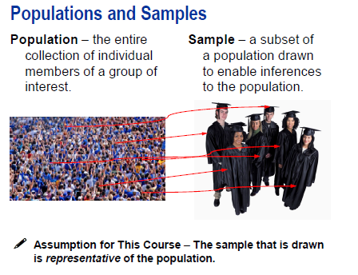
Descriptive Statistics and Picturing Distributions
Once we are clear about levels of measurement and variable types, the next step is to identify or look in to “what already happened in data” by using descriptive statistics and picturing the data.
The first step to do so is to take sample from population.

Slide 10
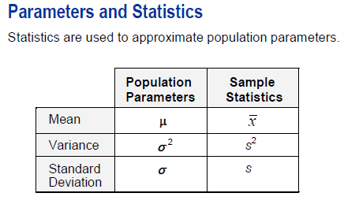
Descriptive Statistics and Picturing Distributions

Slide 11
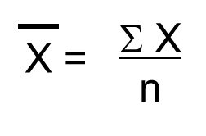
Descriptive Statistics and Picturing Distributions
Measure of Central Tendency: Most of the datasets show distinct tendency to group or cluster about a center point. Thus, for any particular dataset, “one value can be use to describe the entire set”. Such a descriptive value is known as “Central Tendency”. It includes Mean, Median and Mode.
Mean: The mean is a most commonly used measure of central tendency. The mean is calculated by summing all the observed values of variable of interest and then dividing the total by the number of observations.

Slide 12

Descriptive Statistics and Picturing Distributions
Median: The median is the middle value in an ordered array of data. If there is no ties, half the values are less then median and half the values are more then median.
Mode: The mode is the value in set of data which occur most. It is possible sometimes that all the values of variable is unique and hence we can not calculate the mode for that variable.

Slide 13


Descriptive Statistics and Picturing Distributions
Quartiles: Quartiles are most widely used measure of noncentral location. While median is the value that split the data in to 50%-50%, the quartiles are descriptive measure which splits the data into four quarters.
First Quartile (Q1): The Q1 is the value for which 25% observations are smaller and 75% of the observations are larger.
Third Quartile (Q3): The Q3 is the value for which 75% observations are smaller and 25% of the observations are larger.

Slide 14
Descriptive Statistics and Picturing Distributions
Measures of Variation: A second important property to describe the numerical data is the variation. Variation is the amount of dispersion or spread in the data. Five measures of variation are as follow:
Range: The range is the difference between largest and smallest observation in the dataset. It measures the total variation of the variable of interest.
Interquartile Range: Q1 – Q3 also called as mid spread. It measures the spread in the middle 50% of the data.
The range and interquartile range does not take in to account “how all the observations are cluster or distributed”

Slide 15


Descriptive Statistics and Picturing Distributions
Variance and Standard Deviation: These measures evaluate how each observations fluctuate around the mean. The sample variance is simply the average of squared difference between each data value and mean.
The sample standard deviation is the square root of variance.

Slide 16
Descriptive Statistics and Picturing Distributions
Variance v/s Standard Deviation: Both measures the variation around the mean. Variance’s computation results in squared units – square %, square $, squared inches and so on. So the primary measure is the standard deviation whose calculation results in original units of data as like % of return, dollars, or inches.
For almost all the set of data, the majority of the data lies within interval of one standard deviation above the mean and below the mean. So the knowledge of mean and standard deviation helps to know where the majority of the data clustered.

Slide 17

Descriptive Statistics and Picturing Distributions
Coefficient of Variation: It is a relative measure of variation. It is always expressed in terms of % rather than in terms of the units of particular data. It measures the scatter in the data relative to mean. This particular measure helps if we have two variables having different units of measurement.

Slide 18
Descriptive Statistics and Picturing Distributions
As a financial advisor, you are responsible for helping the clients decide which types of mutual funds to invest. For that, the starting step to find out what is the average 3-year annualized return across the risk category.
How much variability present in returns?
Are the returns for high risk funds more variable than for average-risk funds or low-risk funds?
How will you use this information when advising your clients?

Slide 19

DEMO

Slide 20
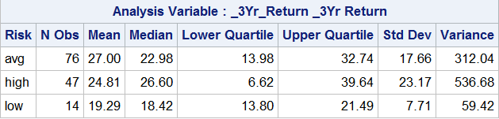
Descriptive Statistics and Picturing Distributions
The variability of high risk fund is greater than average risk funds and that average risk fund’s variability is greater than low risk fund’s variability. So we can say that investors in high risk fund is having greater probability of obtaining a high return or less return respective to mean. Returns from low risk funds tend to cluster more closely around their mean.

Slide 21
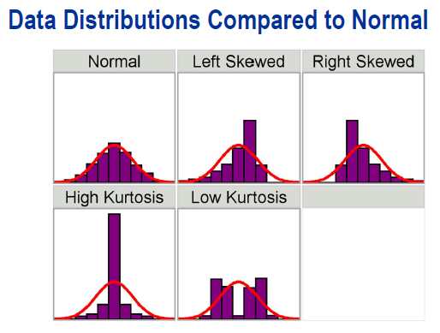
Descriptive Statistics and Picturing Distributions
Shape: The third important property is the shape – the manner in which the data is distributed. “Distribution is nothing but the collection of data values”. Either the distribution is symmetrical or it is not. If the distribution is not symmetrical then it is called asymmetrical or skewed. We can measure the shape by using skewness and kurtosis and also by picturing the data as follow.

Slide 22
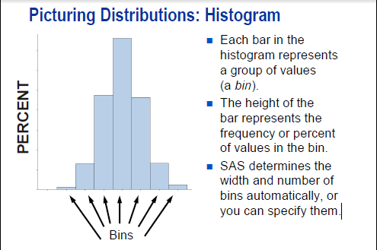
Descriptive Statistics and Picturing Distributions

Slide 23
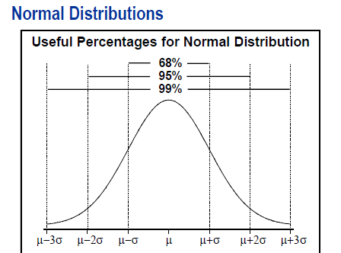
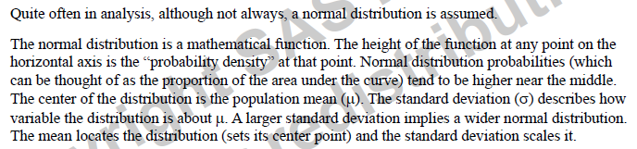
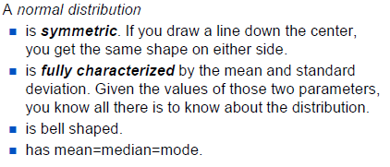
Descriptive Statistics and Picturing Distributions

Slide 24
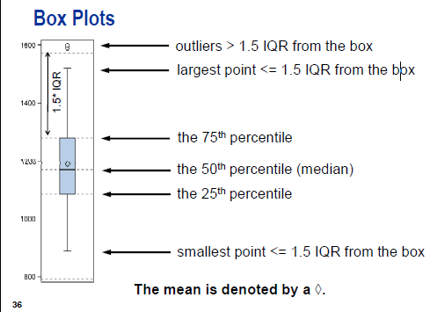
Descriptive Statistics and Picturing Distributions

Slide 25
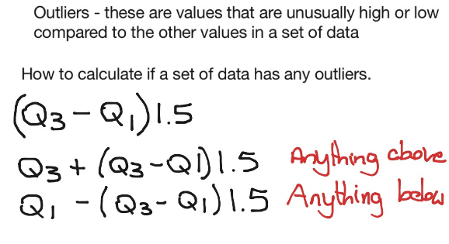
Descriptive Statistics and Picturing Distributions

Slide 26
Descriptive Statistics and Picturing Distributions
If we want to compare the two numeric variables, we can use the “scatter diagram”. Based on our case study, two variables can be Return from 1999 and Return from Q1 2000.
We can plot these two variables and discover the pattern from them as like whether returns from 1999 is same across the range of returns from Q1 2000, whether Q1 2000 returns is increase across the range of 1999 returns.
From the scatter plot, we can not say due to change in one variable affect the other variable. We can not say due to change in 1999 return, Q1 2000 return also changed.

Slide 27
DEMO

Slide 28
Descriptive Statistics and Picturing Distributions
Once we are done with the descriptive measures and visual analysis of data, the next step is to measure how well our sample estimate is. We can check it by using “Standard Error of the Mean” and “Confidence Interval of the Mean”
There can be n-number of samples. Suppose you select a sample of funds and analyze the returns out of it. Tomorrow’s sample can have different values. So we need to check the precision of our sample.

Slide 29
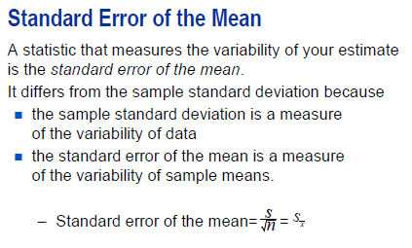
Standard Error of the Mean

Slide 30
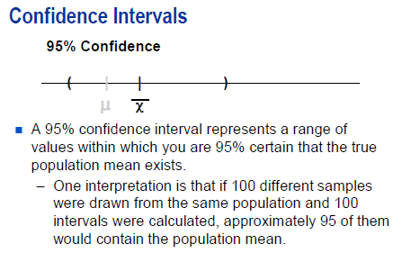
Confidence Interval (CI)

Slide 31
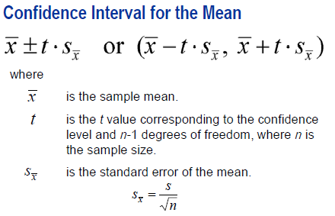
Confidence Interval (CI)

Slide 32
DEMO

Slide 33
Q&A

